Slide 1
Presentation On
Movie Ticket Management System

Slide 2
Project Overview
The purpose of movie ticket booking system is to automate the manual system of buying tickets from physical countries.In this system a user can see the movie list and make a booking.If the user is a member of this system then he/she will get an offer and if not then the user will directly redirect to the total price amount page.

Slide 3
Tools and Techcologies
Hardware Specification
RAM - 2GB
Hard Disk - 1TB
Processor - Intel core i5
Software Specification
Operating System - Windows 10
Code editor - emu8086
Language - Assembly

Slide 4
Flowchart
>
START
OPTION
MEMBER
PRICE
INPUT OPTION
GET OFFER
NOT MEMBER
END

Slide 5
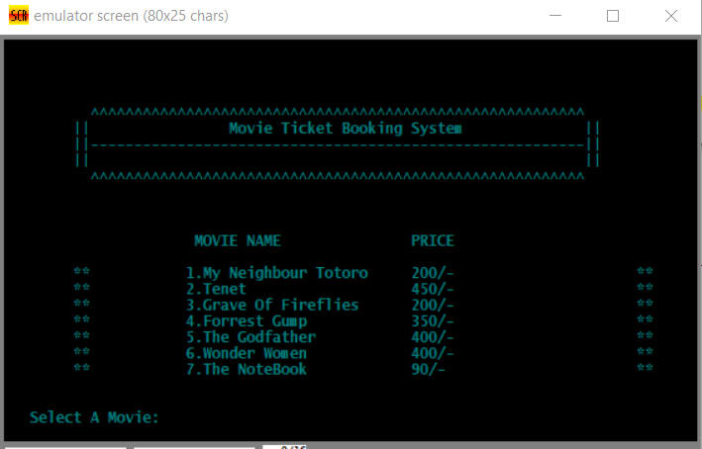
OUTPUT
This will be our output screen.

Slide 6
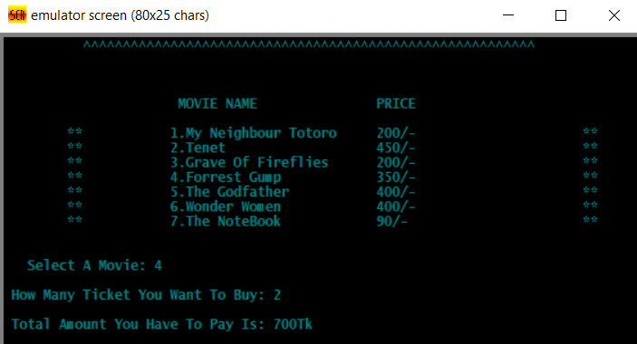
output
After selecting the movie name and quantity of the ticket to buy, Total amount will be displayed.
Mercury
Venus
Mercury is the closest planet to the Sun and the smallest one in the Solar System—it’s only a bit larger than our Moon
Venus has a beautiful name and is the second planet from the Sun. It’s terribly hot, even hotter than Mercury

Slide 7
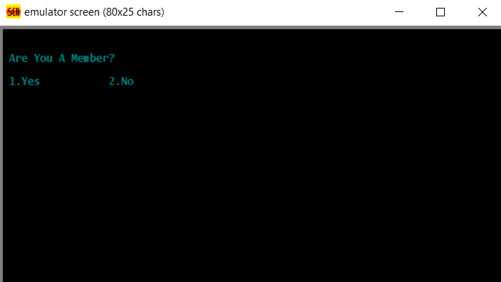
Output
User input will be asked to check whether a member or not.

Slide 8
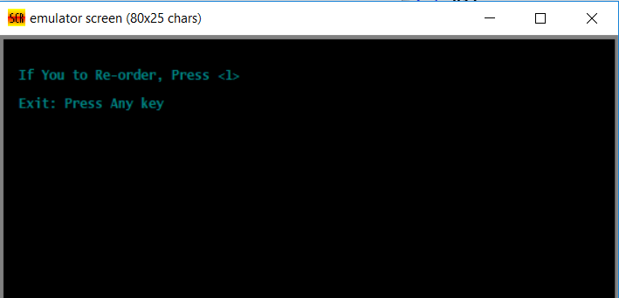
OUTPUT
If the user is not member, then this will be displayed.

Slide 9
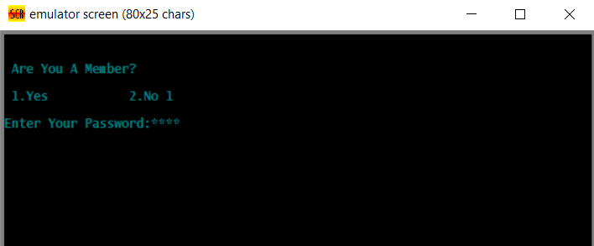
output
If the user is member, user will have to give password to proceed.

Slide 10
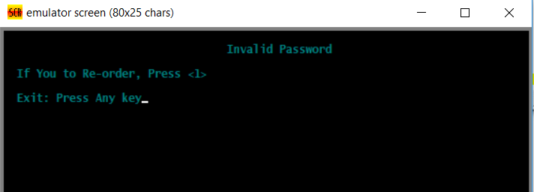
Output
If the user enter wrong password, this will be displayed.

Slide 11
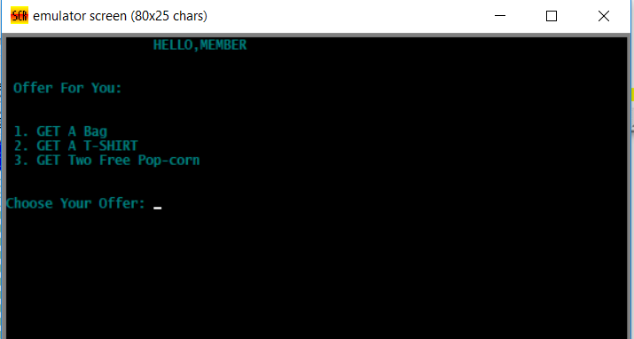
OUTPUT
If the user correctly enter the password ,this will be displayed with some offers.

Slide 12
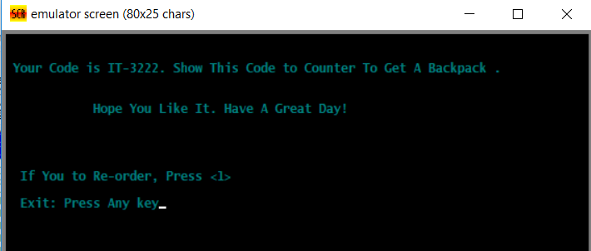
OUTPUT
If the member choose Offer-1, the member will get a code to get the gift.

Slide 13
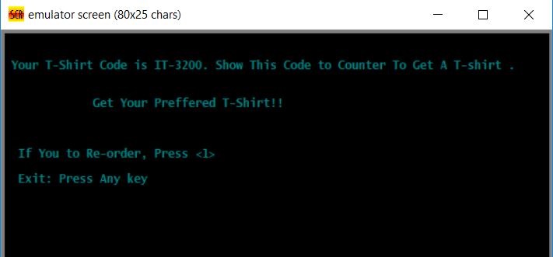
OUTPUT
If the member choose Offer-2, the member will get a code to get the gift.

Slide 14
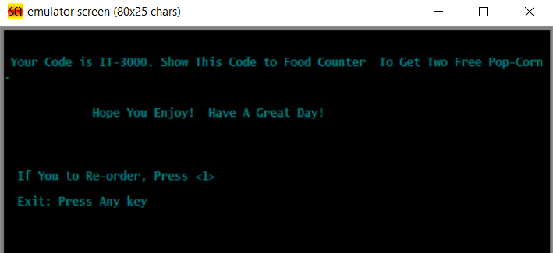
OUTPUT
If the member choose Offer-3, the member will get a code to get the gift.

Slide 15
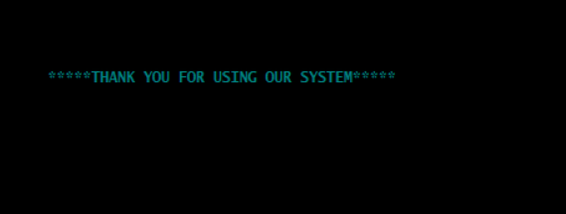
OUTPUT
If the user press the option to exit,this will be displayed.

Slide 16

THANK YOU

